Slide 1
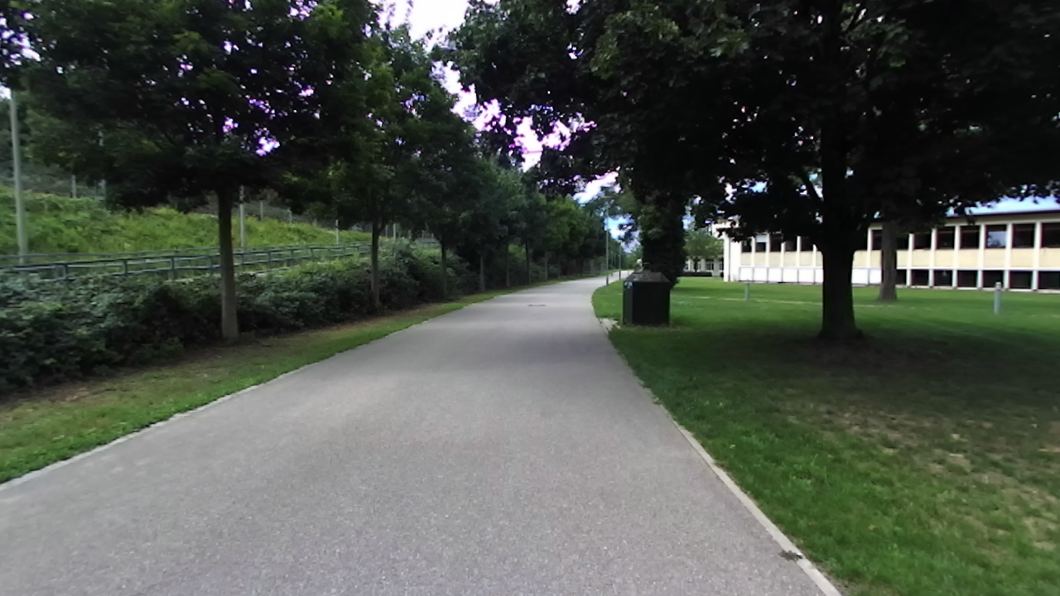
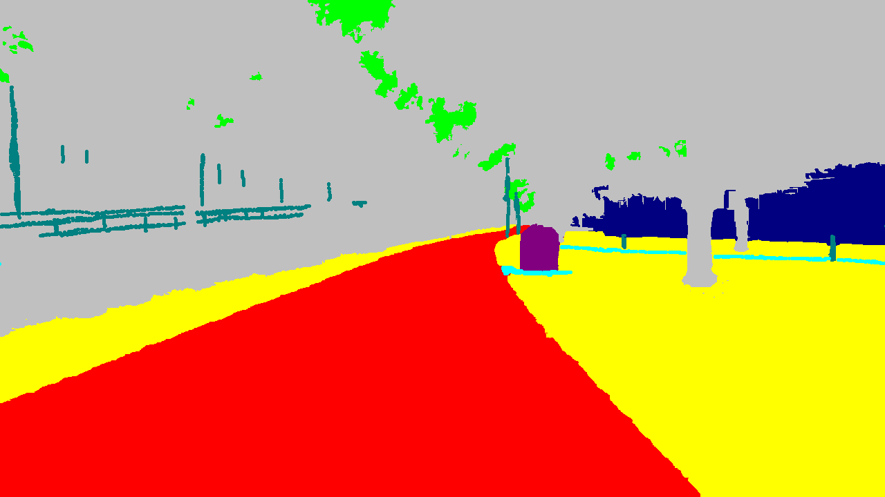
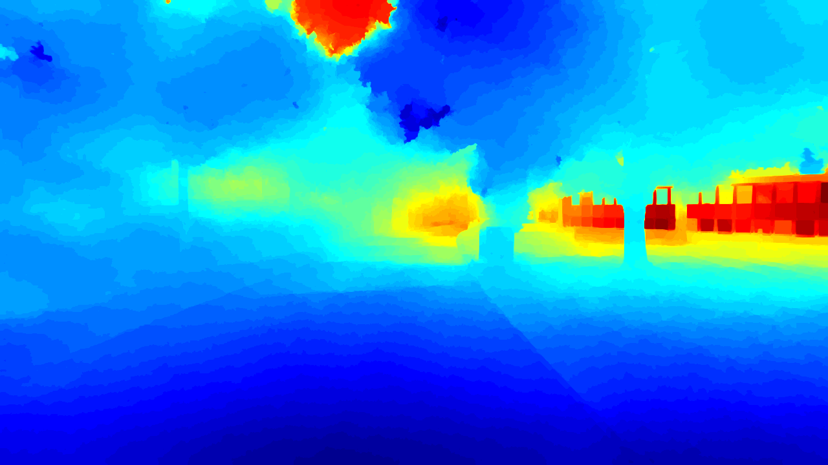
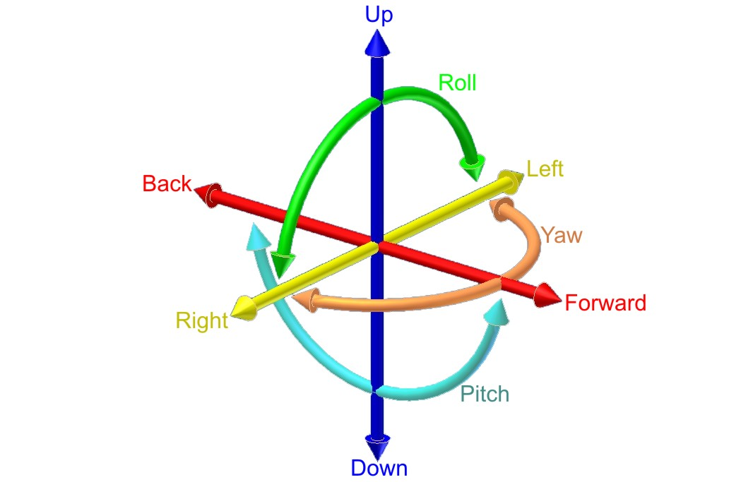
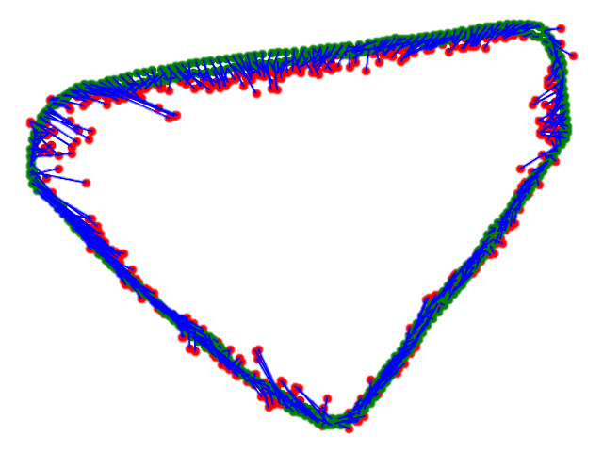
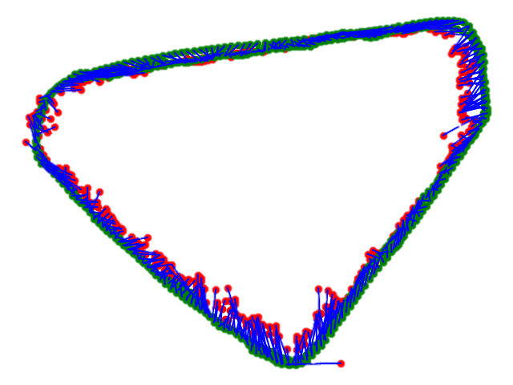
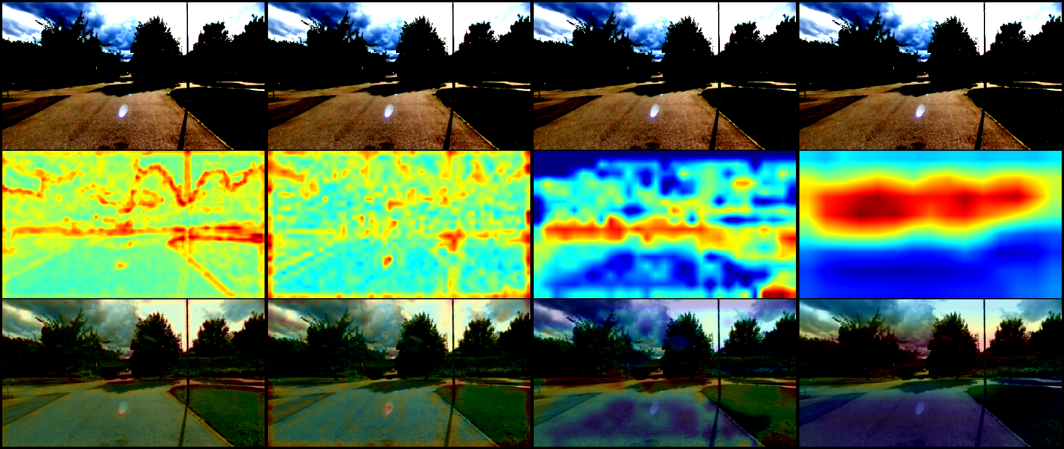
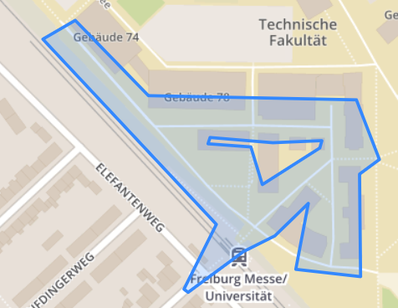
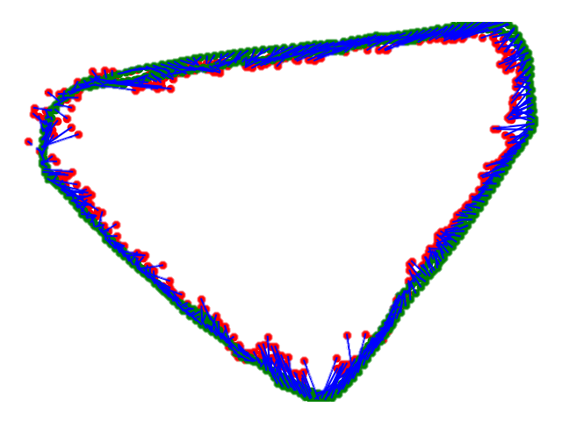
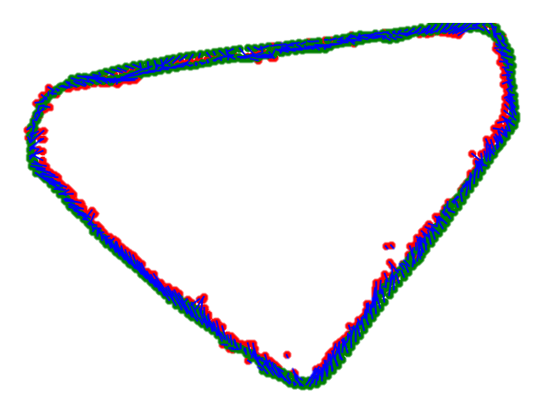
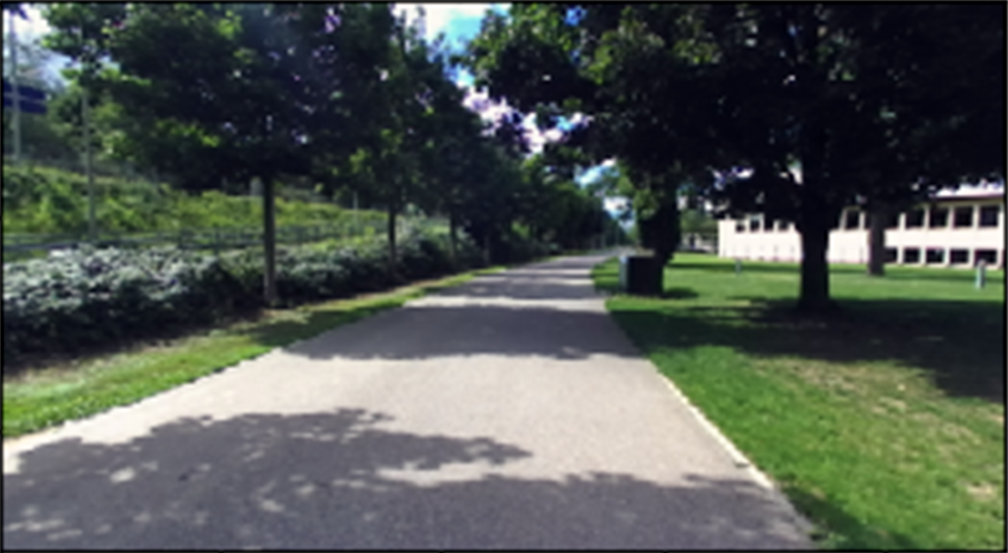
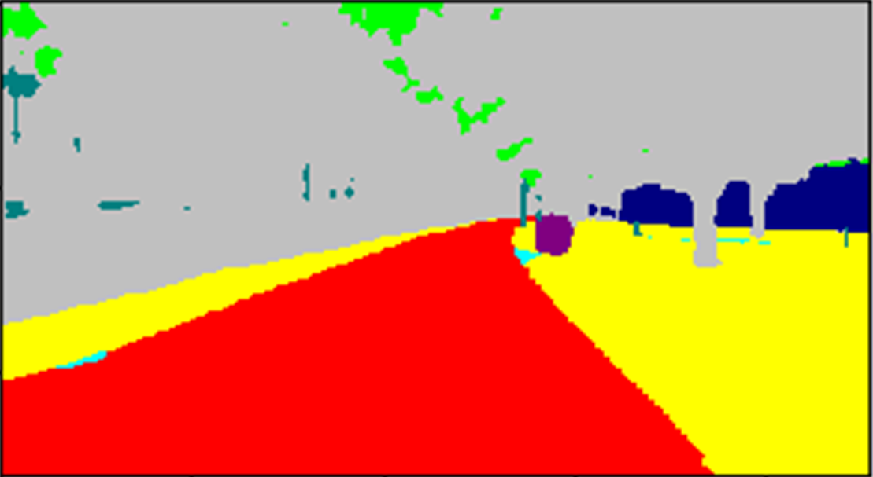

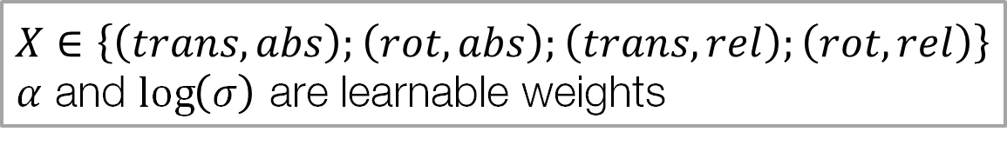
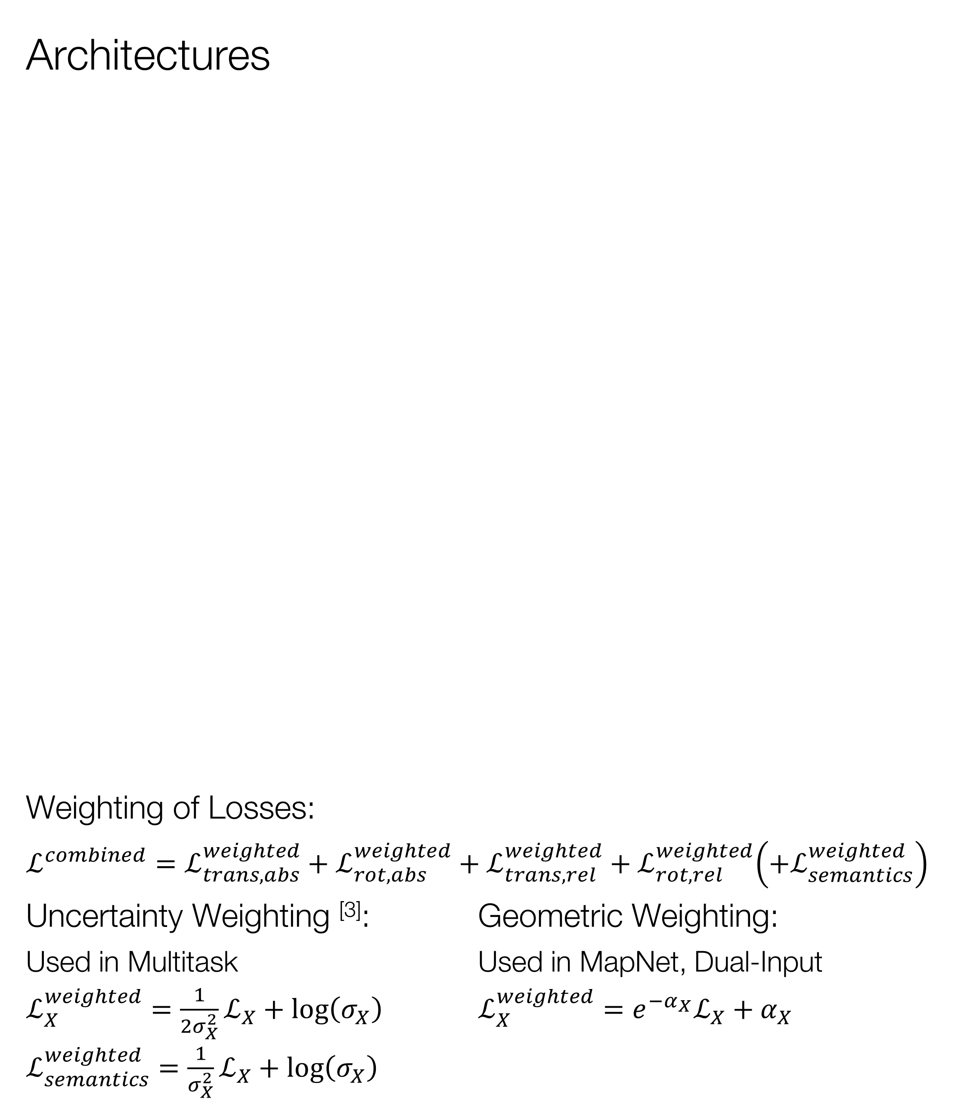
Absolute camera localization Advanced Deep Learning for Computer Vision Leonhard Feiner, Alexander Ziller
Calculation of Camera Poses using Images
Goal: Improve localization accuracy
Dataset DeepLoc ^{[2]}
Pose Accuracy on Validation Set
Initialization influences results significantly
MapNet
RGB Image
Neuronal
Network
6-DoF Pose
MapNet
our work
← OR →
Stereo Images
(only left images used)
Semantic Labels
(only every second image)
Semantic Label
Semantic Label
Dual-Input
Multitask
Architectures
Weighting of Losses:
$ℒ^{combined}=ℒ_{trans,abs}^{weighted}+ℒ_{rot,abs}^{weighted}+ℒ_{trans,rel}^{weighted}+ℒ_{rot,rel}^{weighted}\left(+ℒ_{semantics}^{weighted}\right)$
Uncertainty Weighting ^{[3]}: Geometric Weighting:
Used in Multitask Used in MapNet, Dual-Input
$ℒ_{X}^{weighted}=\frac{1}{2σ_{X}^{2}}ℒ_{X}+\log\left(σ_{X}\right)$ $ℒ_{X}^{weighted}=e^{−α_{X}}ℒ_{X}+α_{X}$
$ℒ_{semantics}^{weighted}=\frac{1}{σ_{X}^{2}}ℒ_{X}+\log\left(σ_{X}\right)$
Multitask
Extension
Depth Images
(not used)
6-DoF Camera Poses
(3 translation, 3 rotation)
Upconvolution
Upconvolution
Upconvolution
Upconvolution
Upconvolution
Semantic Loss
Weighting
Pose Graphs on Validation Set
Area of University of Freiburg
Activation Maps of Residual Blocks ^{[4]}
Pretrained Resnets-34
PoseNet | MapNet
Dual-Input | Multitask
MapNet ^{[1]}
Baseline
RGB Image
Input Block
Residual Block
Residual Block
Residual Block
Residual Block
Block 1 Block 2 Block 3 Block 4
Average Pool
Pose Loss
Dense
Dense
Dual-Input
Extension
Both Map Image
Semantic Image
Input Block
Residual Block
Residual Block
Residual Block
Residual Block
Average Pool
Semantic Prediction on Validation Set
Input Prediction Target
Conclusion
Semantic information improves pose regression Useful as additional semantic input or output
Multitask learns further insights about environment
$$X∈\left\{\left(trans,abs\right);\left(rot,abs\right);\left(trans,rel\right);\left(rot,rel\right)\right\}$$
$α$ and $\log\left(σ\right)$ are learnable weights
[1] Brahmbhatt, Samarth, et al. "Mapnet: Geometry-aware learning of maps for camera localization." arXiv preprint arXiv:1712.03342 (2017).
[2] Radwan, Noha, Abhinav Valada, and Wolfram Burgard. "Vlocnet++: Deep multitask learning for semantic visual localization and odometry." arXiv preprint arXiv:1804.08366 (2018).
[3] Kendall, Alex, Yarin Gal, and Roberto Cipolla. "Multi-task learning using uncertainty to weigh losses for scene geometry and semantics." arXiv preprint arXiv:1705.07115 3 (2017).
[4] Chattopadhay, Aditya, et al. "Grad-cam++: Generalized gradient-based visual explanations for deep convolutional networks." 2018 IEEE Winter Conference on Applications of Computer Vision (WACV). IEEE, 2018.
Notes:
TODOs from Qunjie:
- formula for loss
- more detail of architecture
- why dual input benefits less from pretraining?
mention layer 1 to 4 of activation maps
Dual-input benefits less from pretraining

